Slide 1
Predicate Logic: Succession to the British throne
Excercise 5
Truță David Cristian

Slide 2

1. Transform Hypothesis and conclusion into First order formulas
}
H1: If x is the king and y is his oldest son, then y can become the king.
H2: If x is the king and y defeats x, then y will become the king.
H3: Richard III is the king.
H4: Henry VII defeated Richard III.
H5: Henry VIII is Henry VII’s oldest son.
Conclusion C: Can Henry VIII become king ?
Transformation of the hypothesis and the conclusion in first order predicate formulas:
H1: (∀x) (∀y) (king(x) Λ oldest-son(y, x) → king(y))
H2: (∀z) (∀t) (king(z) Λ defeats(t, z) → king(t))
H3: king(Richard III)
H4: defeats(Henry VII, Richard III)
H5: oldest-son(Henry VIII, Henry VII)
Hypotheses
Domain: D(all people) Variables: x, y, z, t
Constants: Richard III, Henry VII, Henry VIII
Predicate symbols: unary: king(x)
binary: oldest-son(y, x), defeats(y, x)
king : D →{T, F}, king(x) = T, if x is king
oldest-son : D x D →{T, F}, oldest-son(x, y) = T, if x is y’s oldest son.
defeats : D x D →{T, F}, defeats(x, y) = T, if x defeated y.
C: king(Henry VIII)

Slide 3
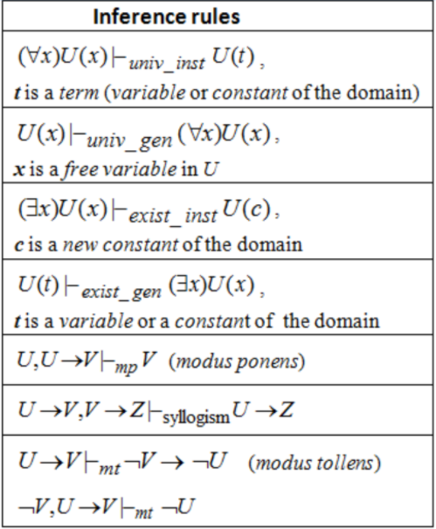
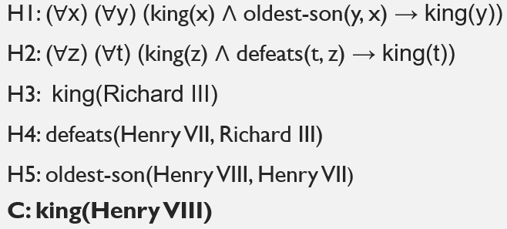
2.Building deductions using inference rules.
Predicate Formulas:
Deductions:
H1 ⊢universal instantiation (king(Henry VII) Λ oldest-son(Henry VIII, Henry VII) → king(Henry VIII)) : F6
H2 ⊢universal instantiation (king(Richard III) Λ defeats(Henry VII, Richard III) → king(Henry VII)) : F7
H3, H4 ⊢conjunction king(Richard III) Λ defeats(Henry VII, Richard III) : F8
F7, F8 ⊢modus ponens king(Henry VII)) : F9
F9, H5 ⊢conjunctions king(Henry VII) Λ oldest-son(Henry VIII, Henry VII) : F10
F10, F6 ⊢modus ponens king(Henry VIII) : F11 = C

Slide 4
3.Conclusion
So C is deductible from (H1, H2, H3, H4, H5, F6, F7, F8, F9, F10, F11)
OR
H1, H2, H3, H4, H5 ⊢ C

